Slide 1

PCA – Three Different TensorFlow Implementations

Slide 2
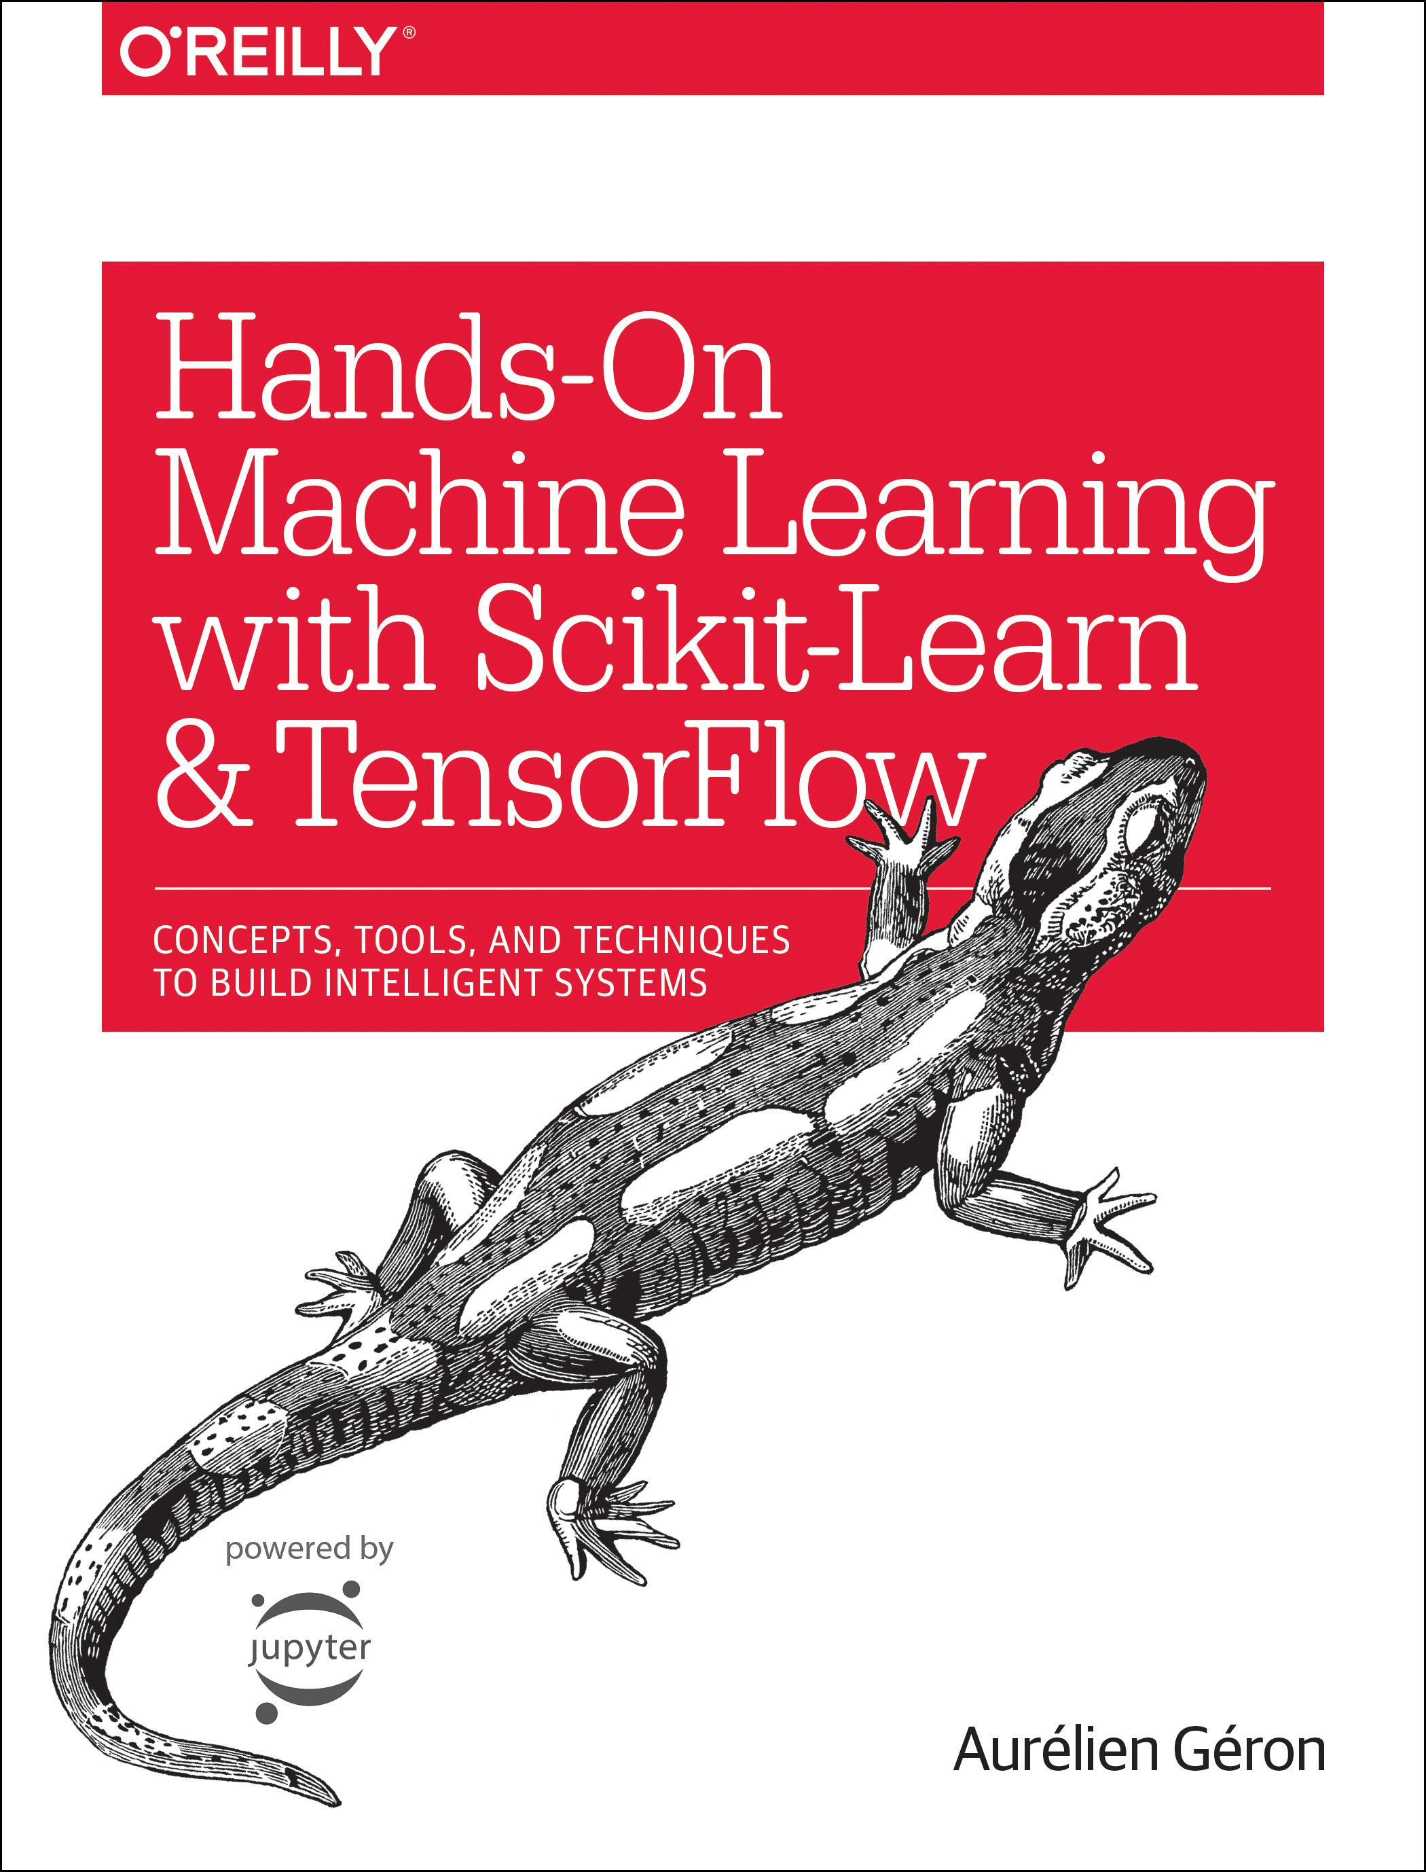
Reference
Chapter 15 (O'Reilly)
Youtube
Code

Slide 3
Data Generation

Slide 4
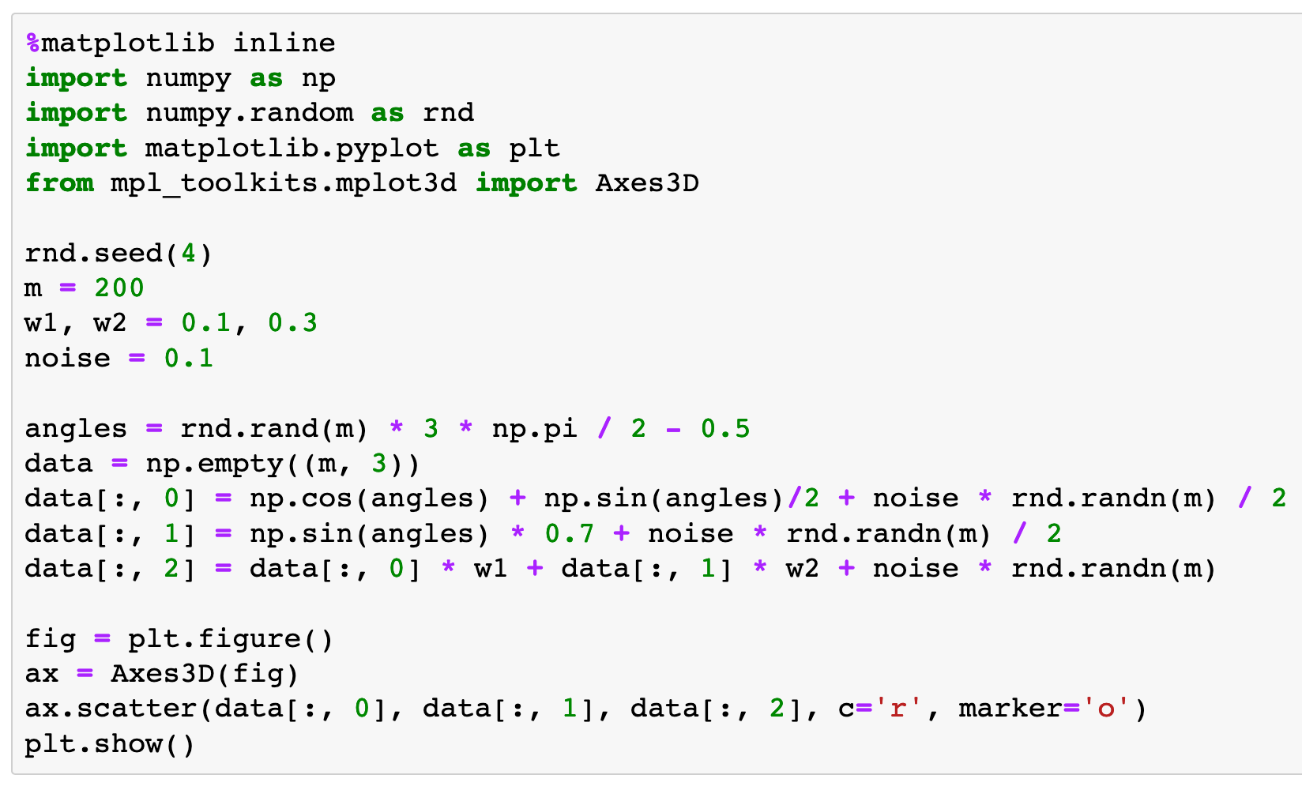

Slide 5
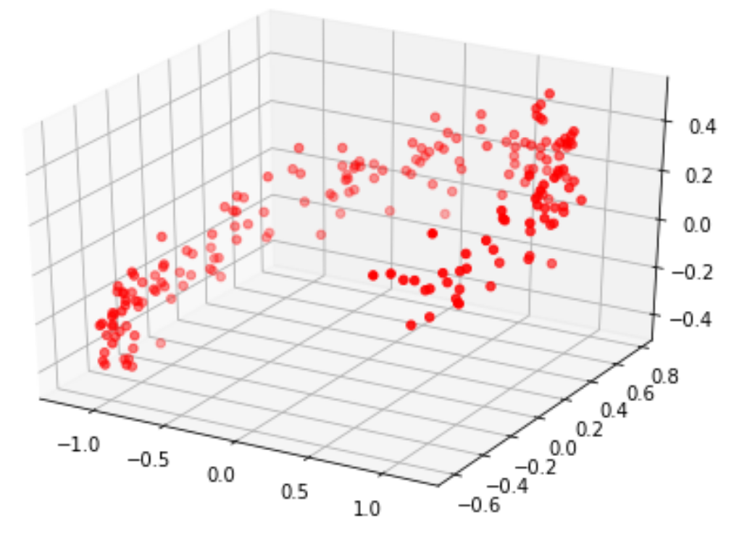

Slide 6
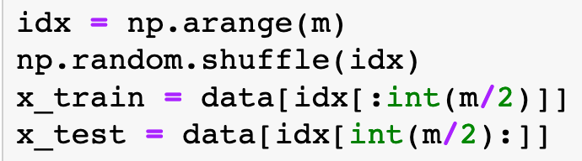

Slide 7
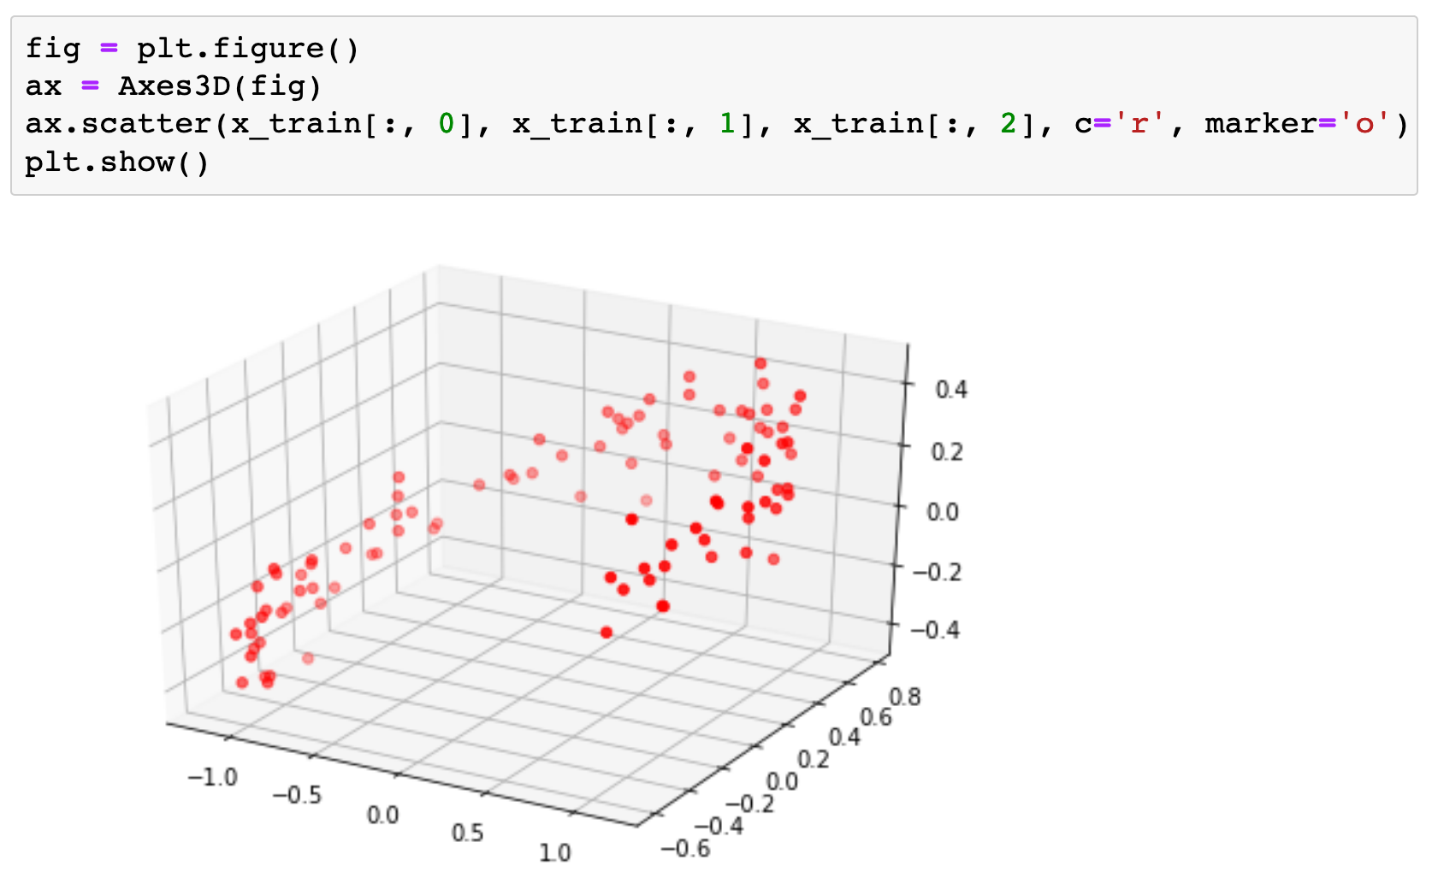

Slide 8
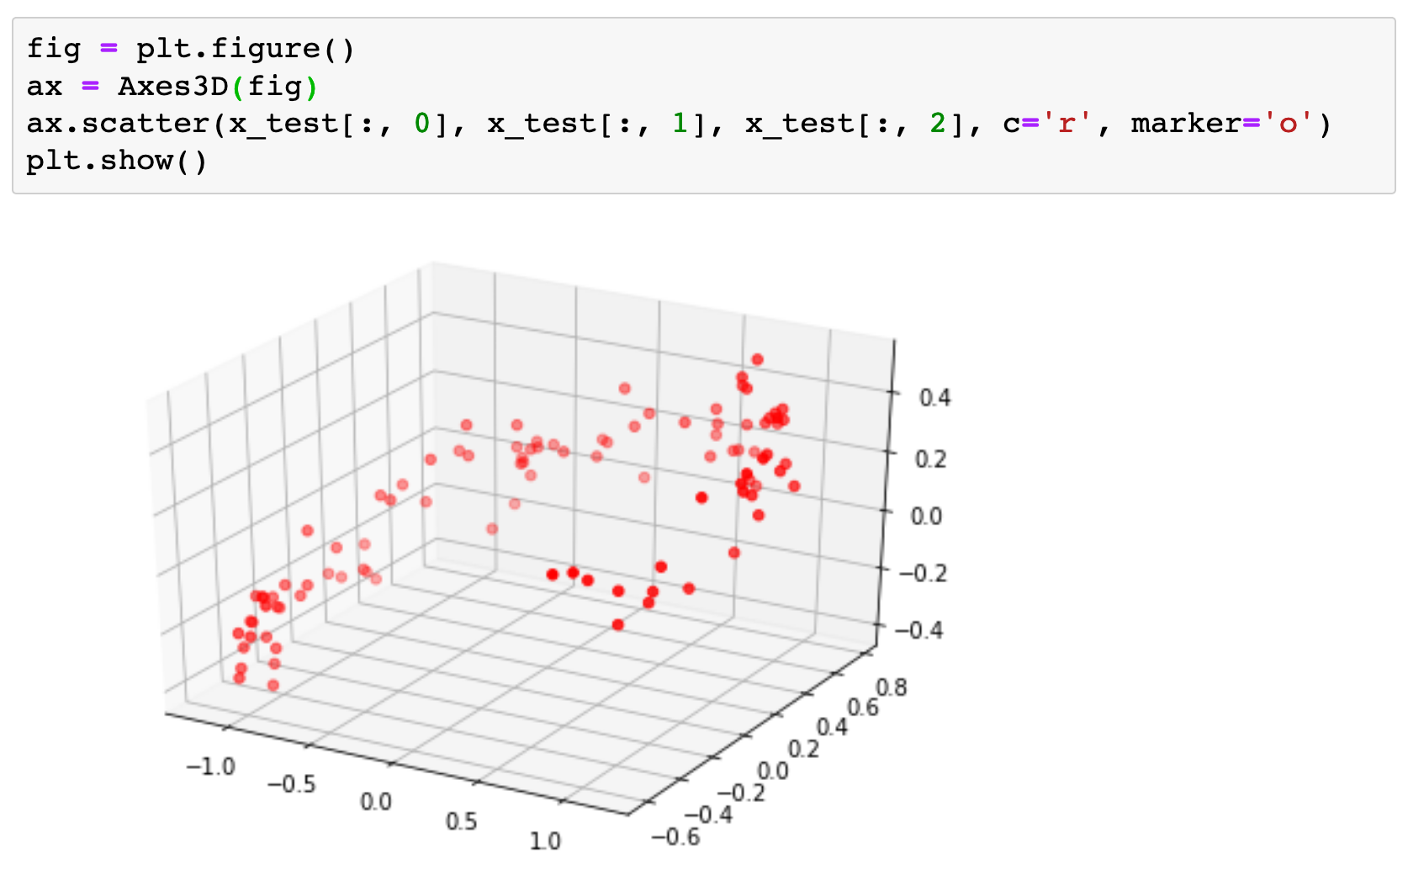

Slide 9
PCA from Scratch

Slide 10
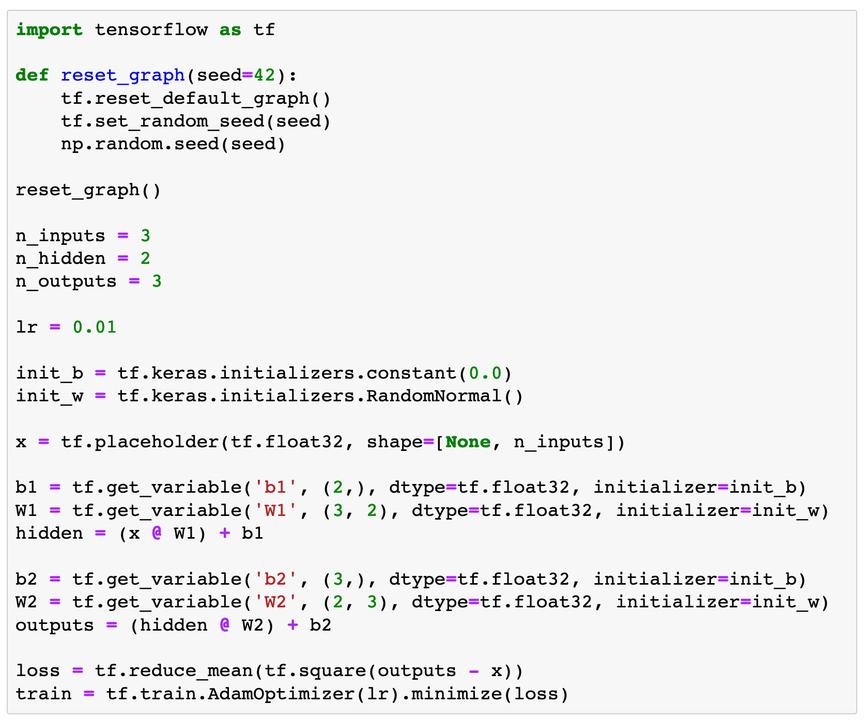
Graph
Construction

Slide 11
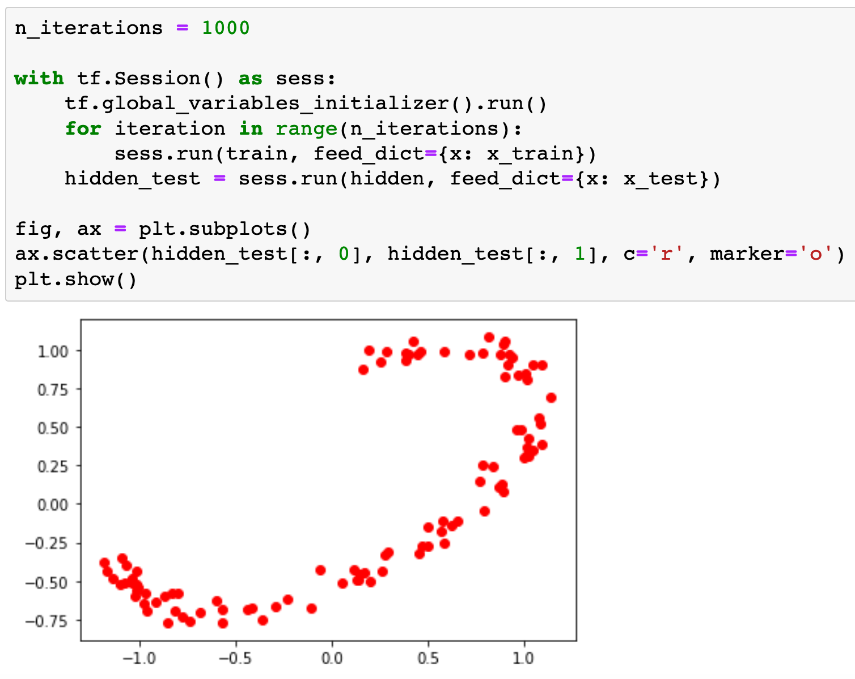
Train
and
Test

Slide 12
PCA using Layers API

Slide 13
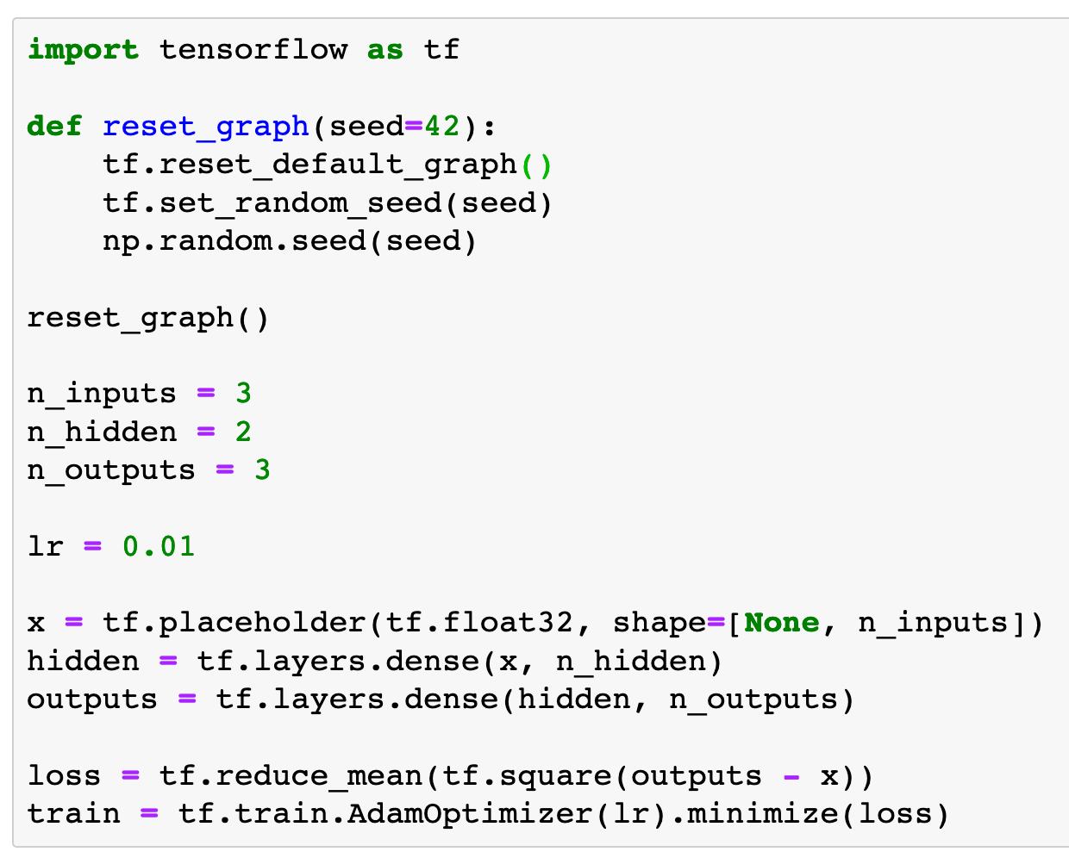
Graph
Construction

Slide 14
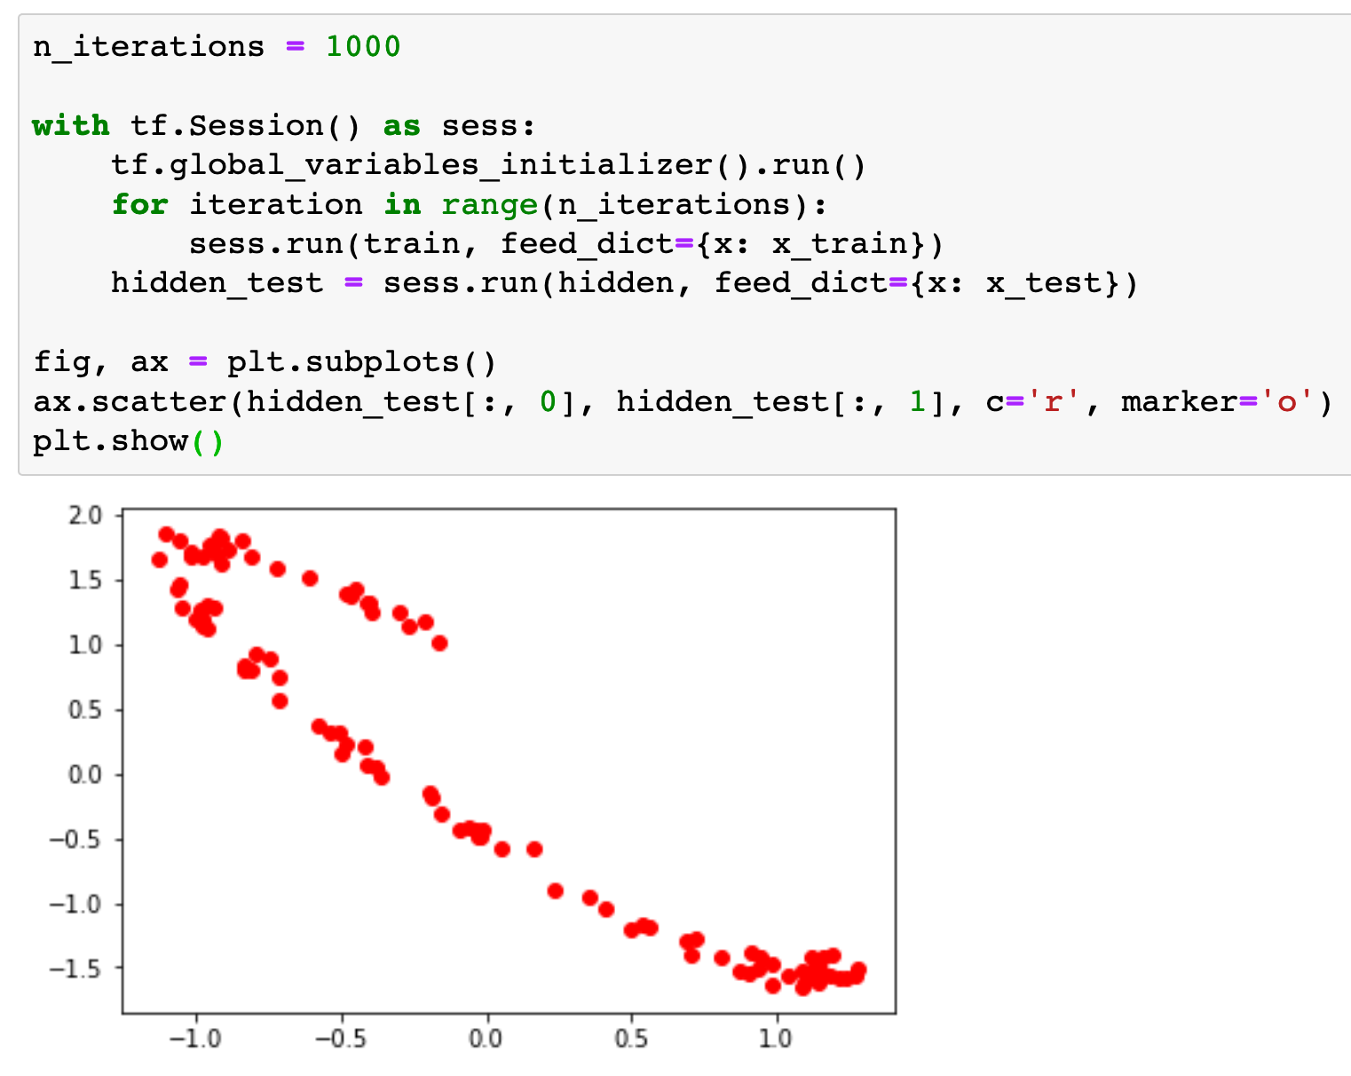
Train
and
Test

Slide 15
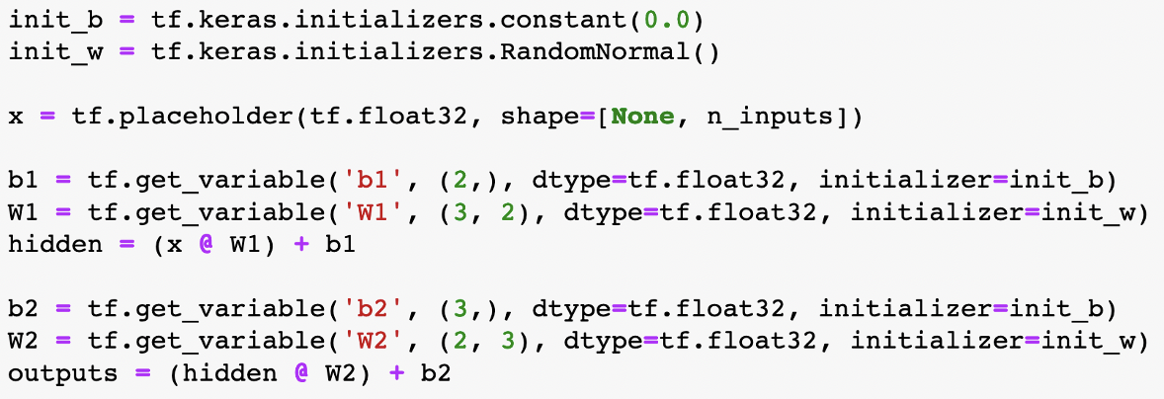
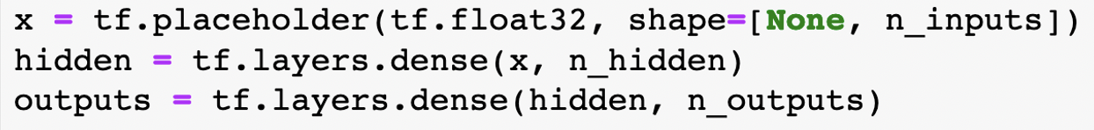
Scratch vs Layers API

Slide 16
PCA using Keras (Eager Mode) API

Slide 17
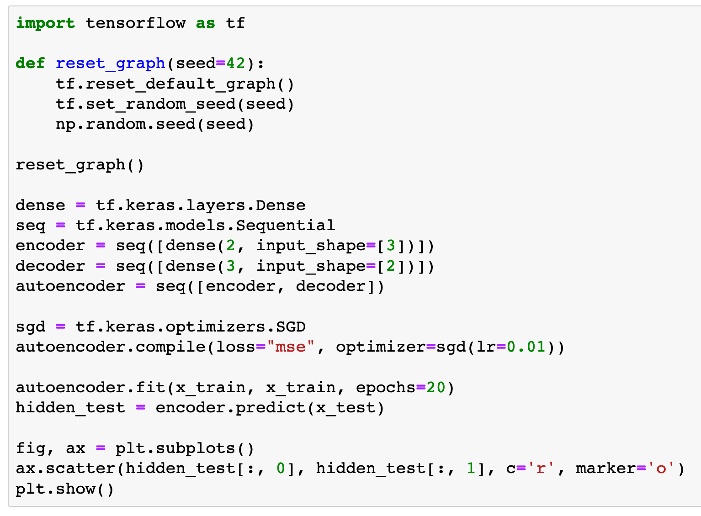

Slide 18
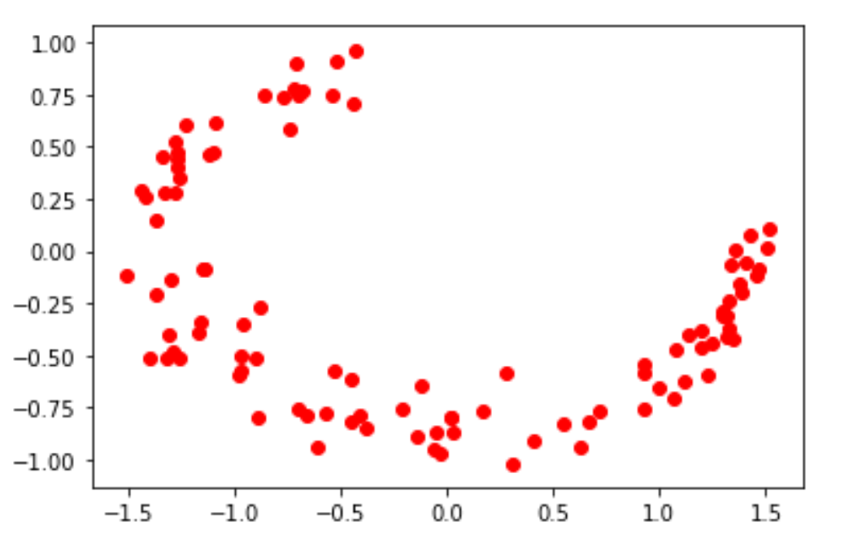

Slide 19
Now
Let’s Play with Code

